Slide 1
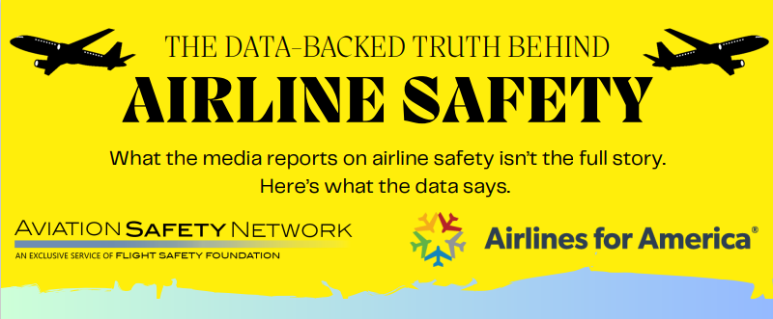

THIS JUST IN! BREAKING NEWS!

Slide 2
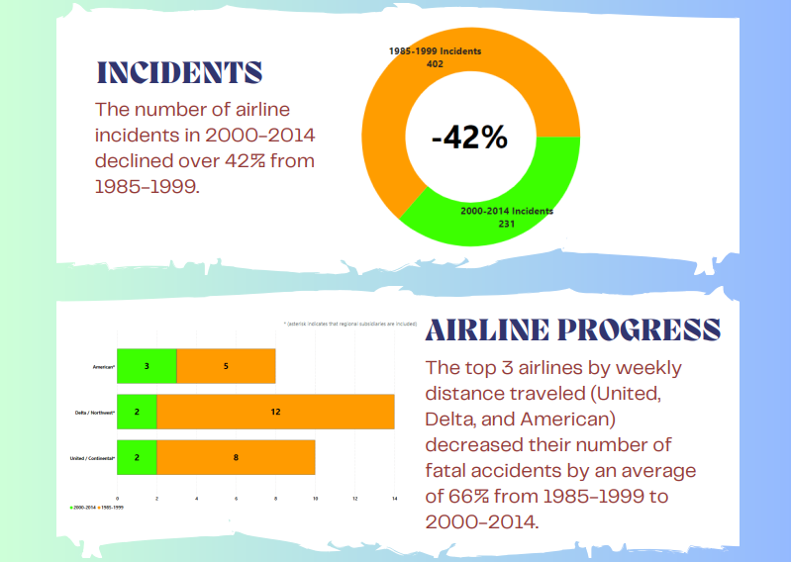

Slide 3
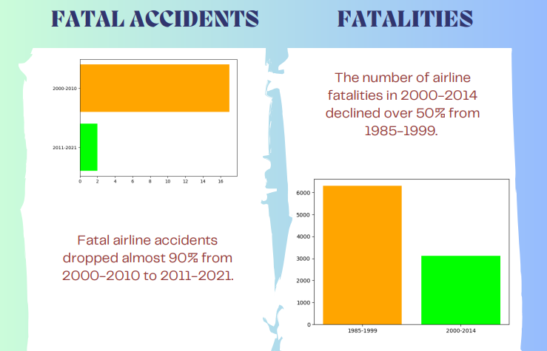

Slide 4
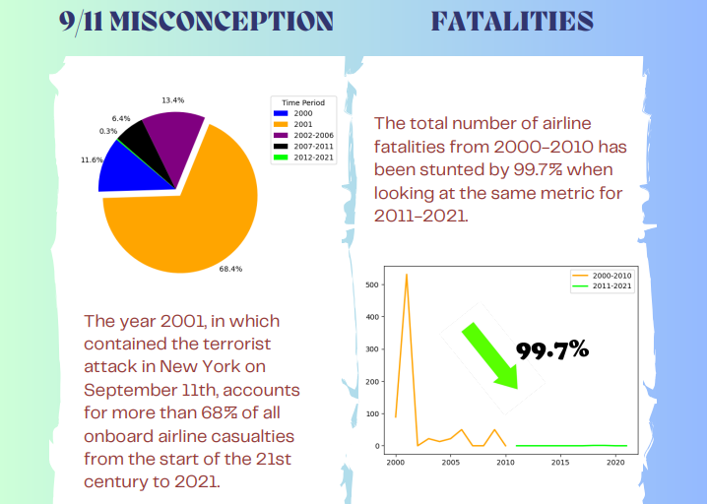

Slide 5




Who can you trust?

Slide 6
REFERENCES
Silver, N. (2014, July 18). Should Travelers Avoid Flying Airlines That Have Had Crashes in the Past? FiveThirtyEight. Retrieved June 15, 2024, from https://fivethirtyeight.com/features/should-travelers-avoid-flying-airlines-that-have-had-crashes-in-the-past/
Airlines for America (2022, December 24). Safety Record of U.S. Air Carriers. Data & Statistics. Retrieved June 15, 2024, from https://www.airlines.org/dataset/safety-record-of-u-s-air-carriers/
Boice, J. (2022, December 16). Airline-safety.Csv. Fivethirtyeight. Retrieved June 15, 2024, from https://github.com/fivethirtyeight/data/blob/master/airline-safety/airline-safety.csv

